Slide 1
ITCS 3143
YIN HANG KWOK
E10 - Sobel Edge Detection

Slide 2
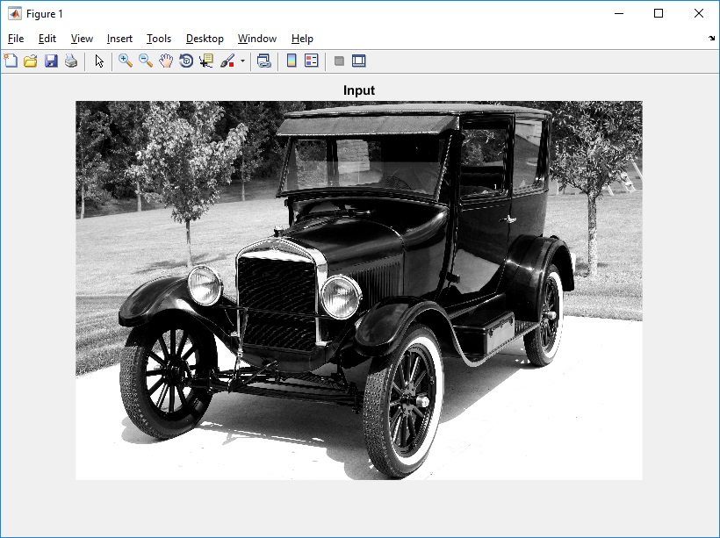
input image (model-t.png)

Slide 3
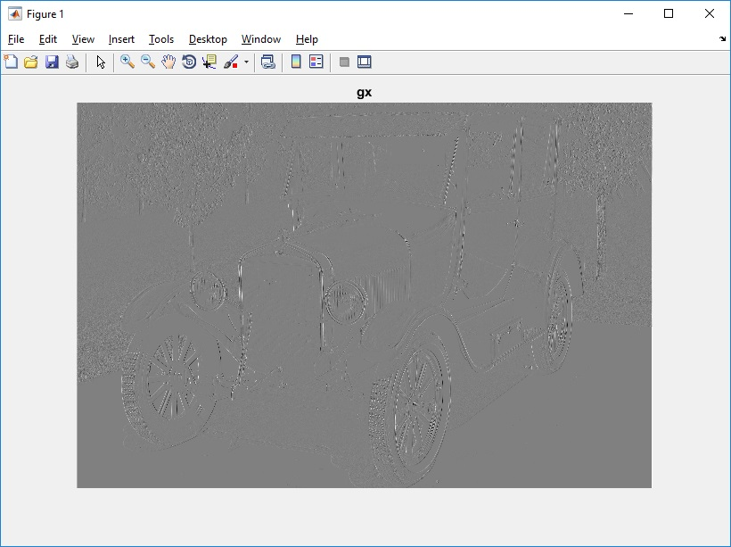
visualization of gx

Slide 4
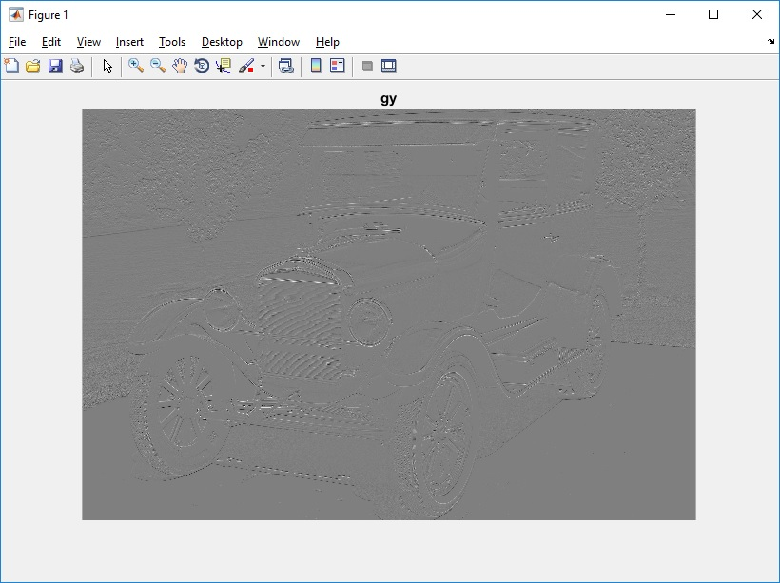
visualization of gy

Slide 5
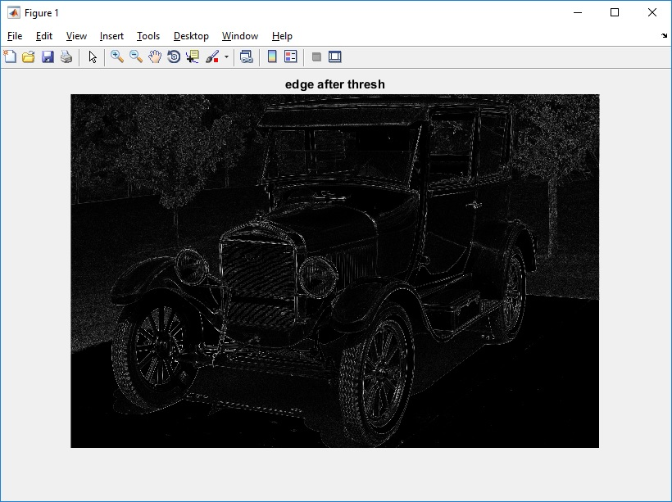
visualization of gm

